Slide 1
DeepSecure: AI Powered IDS for Real-Time Network Traffic
Under the Supervision of
Dr. Jim Solomon Raja D
Assistant Professor Sr. Grade 1
School of Computer Science and Engineering (SCOPE)
BY: RAMANSH VASANIA (22BCI0196)
RAVIPATI ANAGHA (22BCI0228)

Slide 2


Slide 3
INTRODUCTION
Securing Modern Networks in the Age of Cyber Threats
Modern digital systems have grown rapidly with cloud computing, online services, and interconnected networks becoming essential to everyday operations. While this connectivity improves efficiency, it also increases exposure to cyber threats such as unauthorized access, malware, denial-of-service attacks, and zero-day vulnerabilities.
As attack techniques continue to evolve in complexity and frequency, organizations require intelligent security mechanisms capable of continuously monitoring network traffic and identifying suspicious behavior before significant damage occurs.

Slide 4
Limitations of Traditional IDS and Need for AI
Traditional Intrusion Detection Systems rely on static rules and known attack signatures to detect malicious activities. Although effective for previously identified threats, these systems struggle to recognize new and evolving attack patterns.
Artificial Intelligence introduces a behavioral detection approach, where machine learning models learn patterns of normal and abnormal traffic from historical data. This allows modern IDS solutions to adapt to new threats, detect anomalies, and significantly improve detection accuracy and responsiveness.

Slide 5
PROBLEM STATEMENT
Despite advancements in AI-based intrusion detection, many existing systems remain impractical for real-world use. Traditional IDS rely on static signatures and fail to detect unknown attacks, while modern AI-driven solutions often use complex deep learning models that require high computational resources.
Most approaches focus on offline accuracy rather than real-time detection, and their outputs lack interpretability for network administrators. Additionally, detection, alerting, and visualization are often developed separately, resulting in fragmented security systems.
Therefore, there is a need for a lightweight, real-time, and interpretable AI-based intrusion detection system that balances detection performance with practical usability.

Slide 6
RESEARCH OBJECTIVE
The primary aim of this project is to design a practical AI-powered Intrusion Detection System that balances accuracy with real-world usability.
The system focuses on implementing efficient machine learning models for detecting malicious network traffic while maintaining low computational complexity. It aims to enable near real-time intrusion detection, improve alert interpretability, integrate detection and visualization into a single framework, and support adaptability across different intrusion detection datasets.

Slide 7
PROPOSED SYSTEM OVERVIEW
DeepSecure: AI-Based Intrusion Detection System
DeepSecure is a machine learning-driven IDS designed to monitor and analyze network traffic for suspicious activities.
The system is trained using the NSL-KDD dataset and utilizes lightweight classifiers such as Random Forest and Support Vector Machines to learn behavioral traffic patterns.
Incoming traffic records are processed sequentially to simulate real-time detection, generating immediate alerts along with confidence scores. A simple visualization interface presents intrusion events clearly for effective monitoring and response.

Slide 8
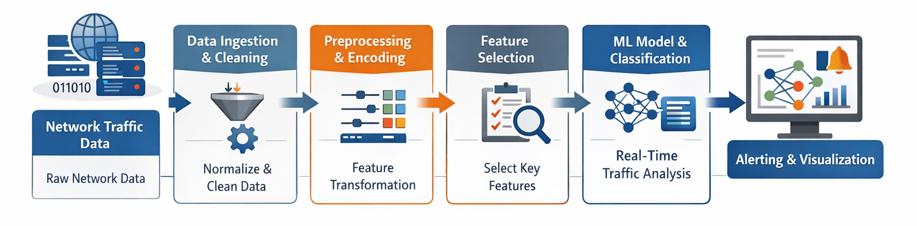
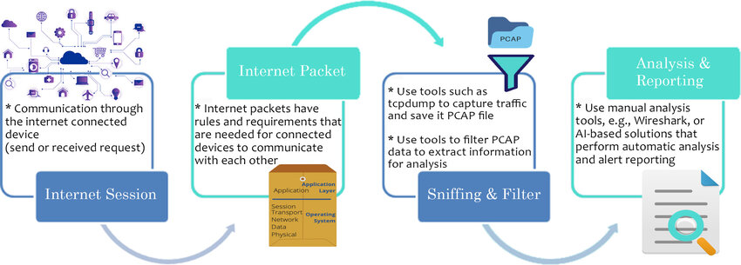
SYSTEM DIAGRAM

Slide 9
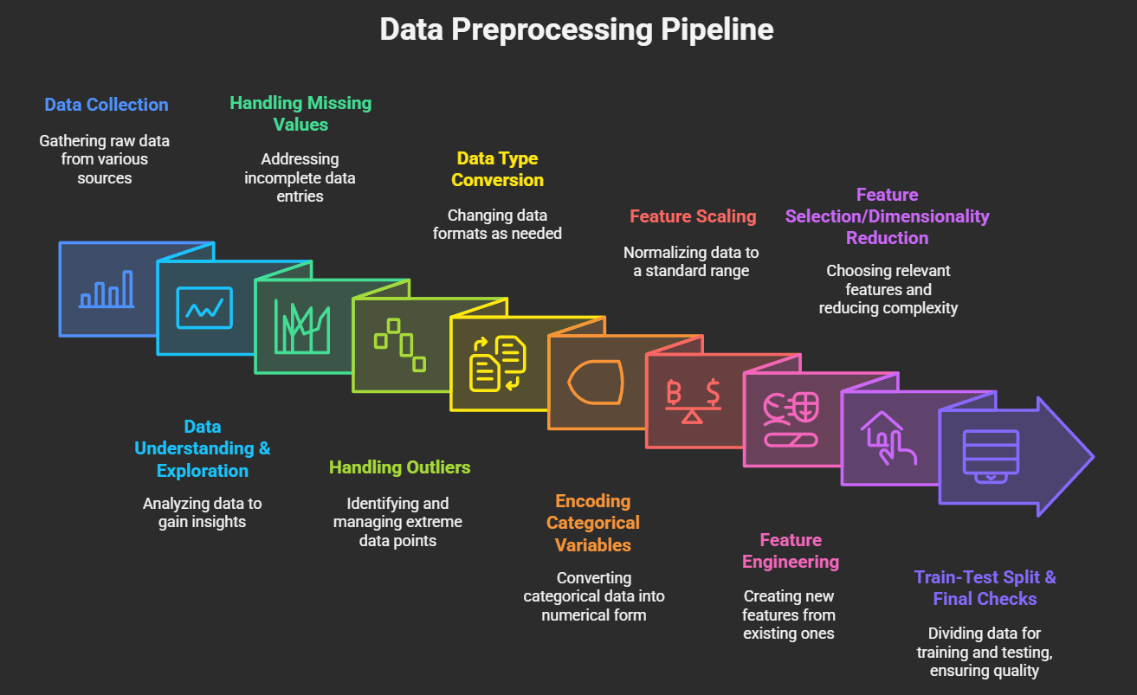
MODULES
Module 1: Data Processing and Preparation
This module is responsible for loading the NSL-KDD dataset and converting raw network traffic records into a structured format suitable for machine learning analysis. It performs data cleaning to remove inconsistencies and missing values, encodes categorical network attributes into numerical form, and normalizes continuous features to maintain uniform scales. The class labels are also simplified into normal and malicious categories to support binary classification. The output of this module is a clean, well-organized dataset that forms a reliable foundation for accurate intrusion detection.

Slide 10
Module 2: Feature Optimization and Model Training
In this module, the most relevant network traffic features( src_ip, dst_ip, protocol, duration, src_bytes, dst_bytes, count) are identified using feature importance and selection techniques to eliminate redundancy and improve computational efficiency. The optimized feature set is then used to train machine learning models such as Random Forest and Support Vector Machines to recognize patterns associated with normal and malicious behavior. Through iterative training and validation, the models learn to achieve high detection accuracy while maintaining lightweight performance. This module serves as the intelligence core of the DeepSecure intrusion detection system.

Slide 11
Module 3: Real-Time Intrusion Detection
This module simulates real-time network monitoring by processing incoming traffic records sequentially. Each data instance undergoes preprocessing before being immediately classified by the trained machine learning model. The system generates a detection decision along with a confidence score, enabling rapid identification of suspicious activities. This real-time detection capability ensures timely responses to potential cyber threats and enhances network security.

Slide 12
Module 4: Alerting and Visualization
The final module focuses on presenting detection results in a clear and actionable manner. Identified intrusions are logged and displayed through an intuitive visualization dashboard that highlights traffic status, alerts, and summary statistics. This allows network administrators to quickly interpret security events and prioritize responses. By integrating detection and visualization into a unified interface, the system improves operational efficiency and real-world usability.

Slide 13
Research Gaps to Be Solved
1.⁠ ⁠Too complex to use in real life
Most modern IDS use heavy deep learning models. They are accurate but need high computing power and are hard to deploy.
2.⁠ ⁠Not focused on real-time detection
Many systems work only on offline data.They don’t detect attacks instantly, which is critical in real networks.
3.⁠ ⁠Hard to understand alerts
AI-based IDS often act like black boxes. Admins get predictions but no clear explanation of threats.
4.⁠ ⁠Overdependence on deep learning
Researchers assume deep learning is necessary for new attacks. Simpler machine learning methods are often ignored despite being effective.
5.⁠ ⁠No complete end-to-end system
Most work focuses only on detection models. Alerting and visualization are rarely integrated.
6.⁠ ⁠Limited adaptability
Systems are tested on one dataset and not proven for other networks.

Slide 14
NSL-KDD Dataset Overview
The NSL-KDD dataset is used to train, validate, and test the DeepSecure machine learning–based intrusion detection system.
Each record in the dataset corresponds to a network connection or session, not an individual packet, making it suitable for flow-based intrusion detection.
The dataset contains 41 carefully selected features that describe network behavior, including connection duration, protocol type, service used, byte transfer statistics, error rates, and host-based traffic features.
Both normal network traffic and malicious traffic are included, allowing the model to learn patterns that distinguish attacks from legitimate activity.
Attack records are labeled and categorized into four major classes: Denial of Service (DoS), Probe, Remote to Local (R2L), and User to Root (U2R).
The dataset is divided into training and testing sets, enabling fair evaluation of model performance on unseen data.
NSL-KDD supports binary classification for intrusion detection as well as multiclass classification for identifying different attack categories.
Its structured and labeled nature makes it well-suited for machine learning-based IDS development and evaluation.

Slide 15
Attacks Identified using NSL-KDD dataset
Denial of Service (DoS) attacks aim to overwhelm network or system resources, causing services to become unavailable to legitimate users by flooding traffic or exploiting protocol weaknesses.
Probe attacks focus on reconnaissance activities such as scanning hosts and ports to gather information about network topology, open services, and potential vulnerabilities.
Remote to Local (R2L) attacks occur when an attacker without an account on the target system exploits vulnerabilities or weak credentials to gain local user access.
User to Root (U2R) attacks involve a local user exploiting system flaws to escalate privileges and obtain root-level access, leading to complete system compromise.

Slide 16
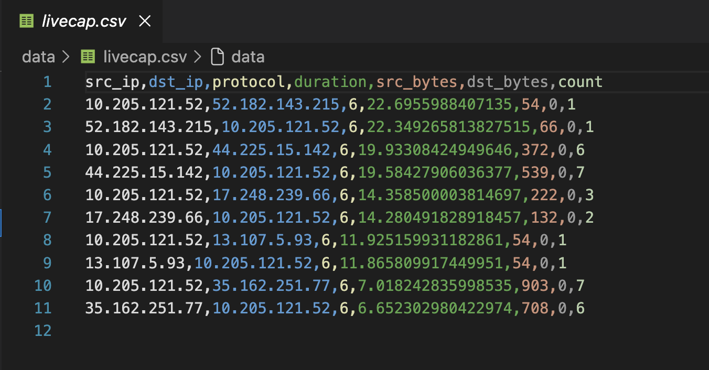
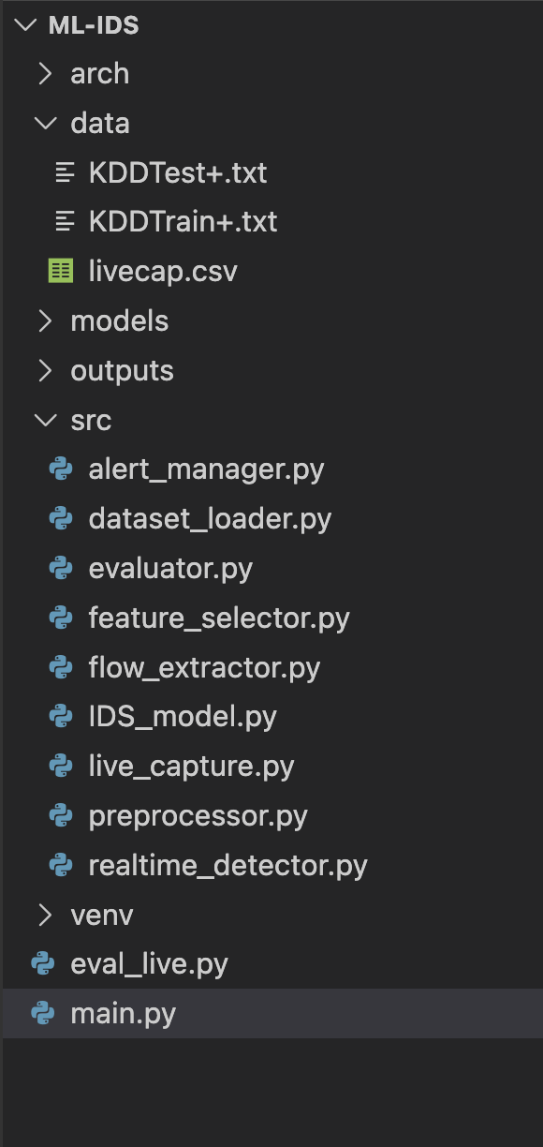
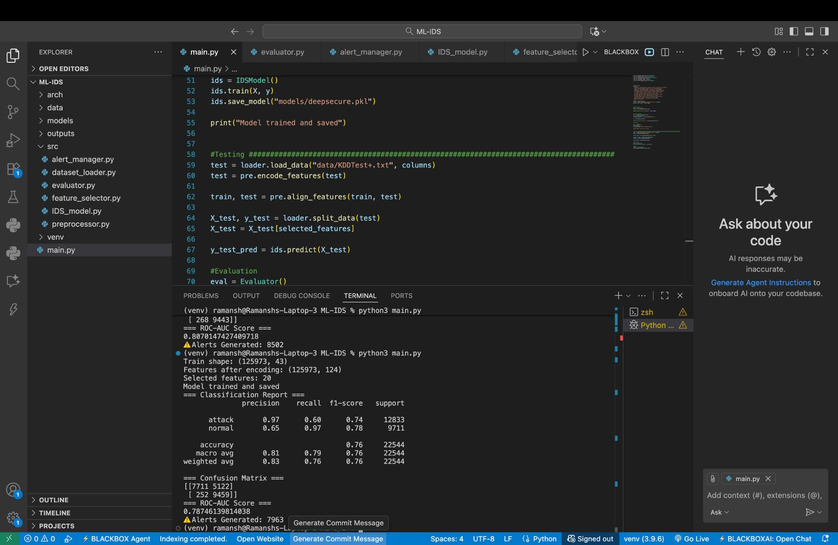
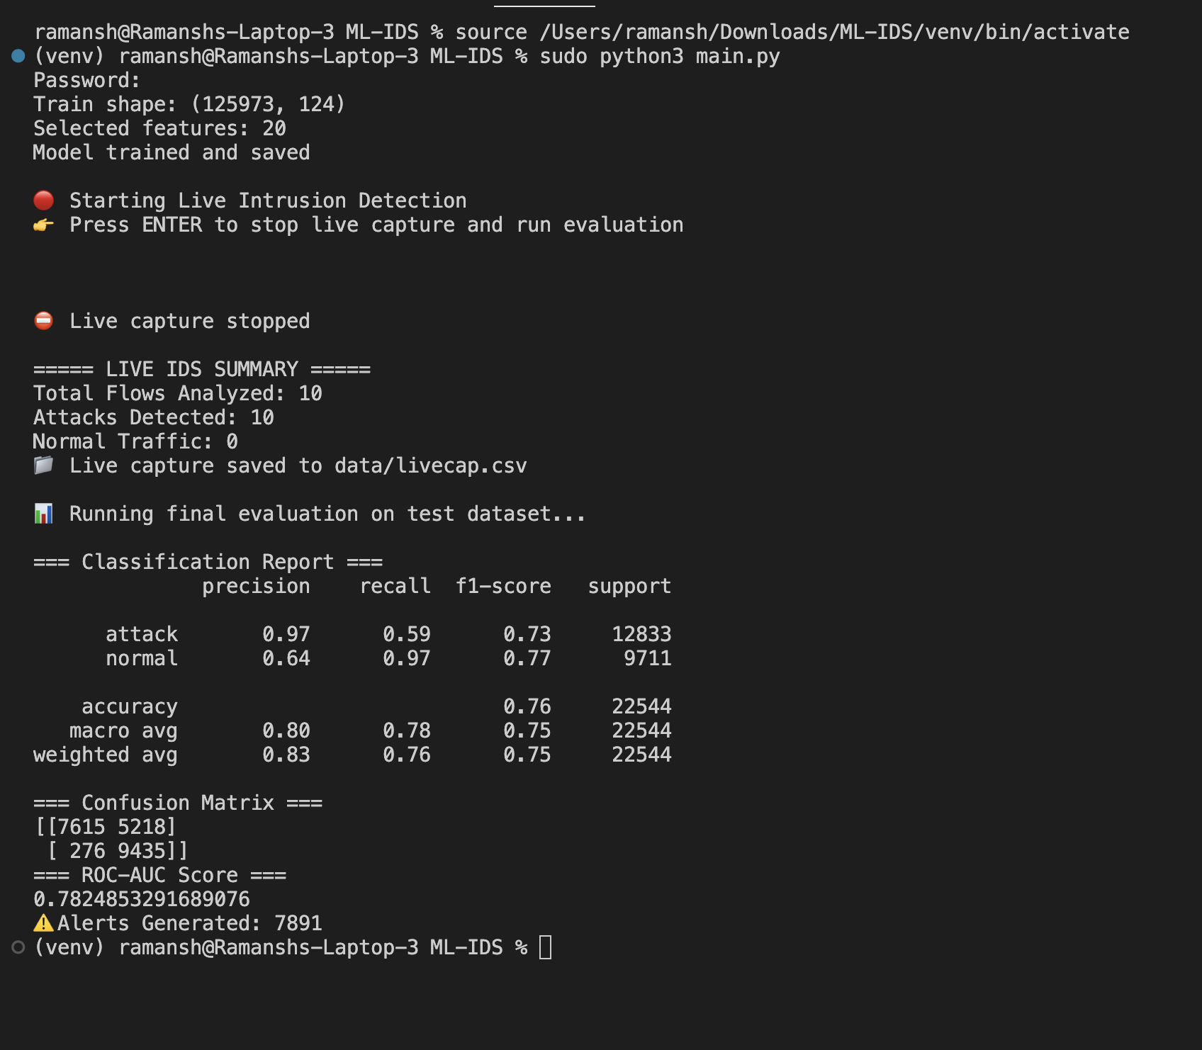
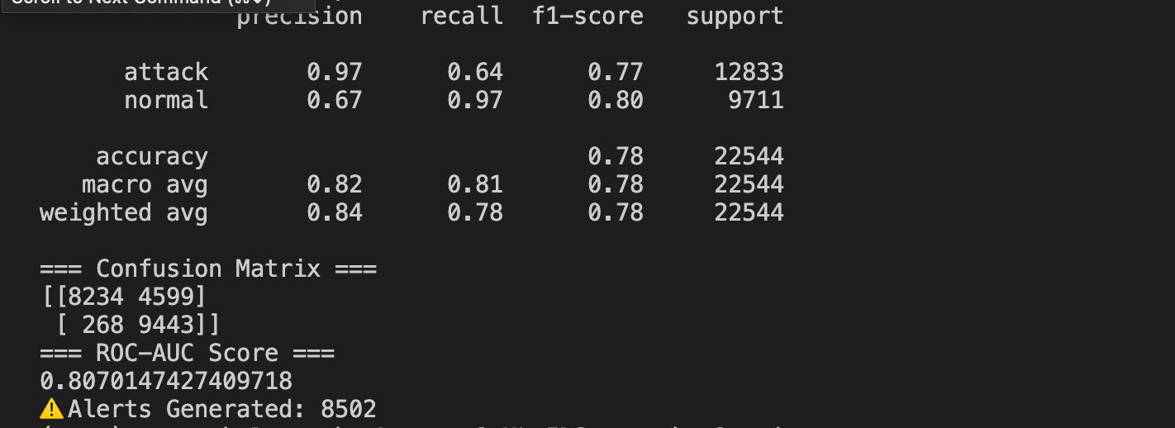
IMPLEMENTATION AND RESULTS

Slide 17
IMPLEMENTATION AND RESULTS
Left Section (Model Implementation): Displays the core Python implementation developed using modular scripts for data loading, pre-processing, feature selection, model training, and evaluation. The system is trained and tested on the NSL-KDD dataset, following a structured ML pipeline.
Top Right (Live Capture Data): Shows network traffic captured in real time and stored in livecap.csv, containing features such as source/destination IPs, protocol, duration, and byte counts. This validates real-world data ingestion beyond offline datasets.
Bottom Right (Live Detection Execution): Demonstrates the execution of the live intrusion detection module, where captured traffic is analyzed using the trained model. The system classifies traffic as normal or attack and generates alerts dynamically.
Bottom Left (Evaluation Metrics): Presents classification results including precision, recall, F1-score, accuracy, and confusion matrix, indicating effective detection performance with balanced results across classes.

Slide 18
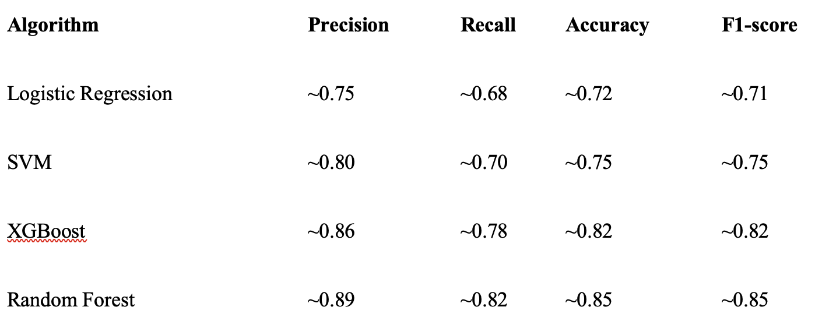
Simulation and Evaluation Results
NSL-KDD Dataset(Results)

Slide 19
Simulation and Evaluation Results
Our project achieved the most consistent and reliable performance using the Random Forest algorithm, delivering detection results close to the desired accuracy and recall levels. We also evaluated Logistic Regression, Support Vector Machine (SVM), and XGBoost to compare different learning approaches. Based on the comparative performance analysis across multiple evaluation metrics, Random Forest demonstrated superior stability and effectiveness, making it the most suitable algorithm for this intrusion detection task.

